Slide 1

KESHAVJI BHARMAL SUMARIA COMMERCE & NATARAJ PROFESSIONAL SCIENCES COLLEGE, VAPI
A
Project Report on
Restaurant Management System
Submitted BY
39 – Vipul Maurya / 75 – Adarsh Singh
Under the guidance of
Ms. Mayuri Patel

Slide 2
Restaurant Management System

Slide 3
INTRODUCTION
A Restaurant Management System Project focuses on simplifying and computerizing the operations of restaurants. The primary objective of an RMS is to properly organize and manage the menu and orders available in a restaurant, making it easier for management to carry out optimizing orders issue operations and create a user-friendly experience for customers.
Restaurant Management System Project records and maintains orders details so that it is easily accessible.
It efficiently manages the menu details to ensure easy navigation, quick orders of information, and seamless interaction with the system.
It manages food ordering effectively as well calculate fine based on time.
It efficiently manages orders request for user.
It generates daily reports that help the manager to track the system operations.

Slide 4
PROJECT USERS AND FUNCTIONALITIES
Educator
• Register and login using authentication system
• Manage personal profile details
• Browse and search courses by keywords
• View detailed course information before purchase
• Purchase courses through payment integration
• Access and view enrolled courses
• Watch course lectures using video player
• Track course progress
• View and download certificates after completion
• Add or remove courses from wishlist
• Interact with AI-based chat system for assistance
• Ask questions in the Q&A section
• View, edit, and delete their own questions
• Post answers to questions and manage their answers
• View announcements shared by educators
• Access additional course resources such as files and links
• Provide ratings and reviews for courses

Slide 5
PROJECT USERS AND FUNCTIONALITIES
Student
• Register and login using authentication system
• Manage personal profile details
• Create and publish new courses
• Add course details including content, pricing, and thumbnails
• Upload lectures and structure course content
• View and manage their own courses
• Monitor students enrolled in their courses
• Share announcements related to courses
• Assign tasks or updates to students
• Upload and manage additional resources such as files and links
Guest
• Browse available courses
• Search courses by keywords
• View course details including description and content
• View course ratings and reviews

Slide 6
PROJECT PROFILE
Project Title | EDEMY
Project Type | Web Application
Font End Technologies | React
Back End Technologies | MongoDB, Node.js, Express.js
Duration | 3 Months
Internal Guide | Pritesh Sir
Submitted By | Shubham Mohapatra

Slide 7
DATA FLOW DIAGRAM

Slide 8
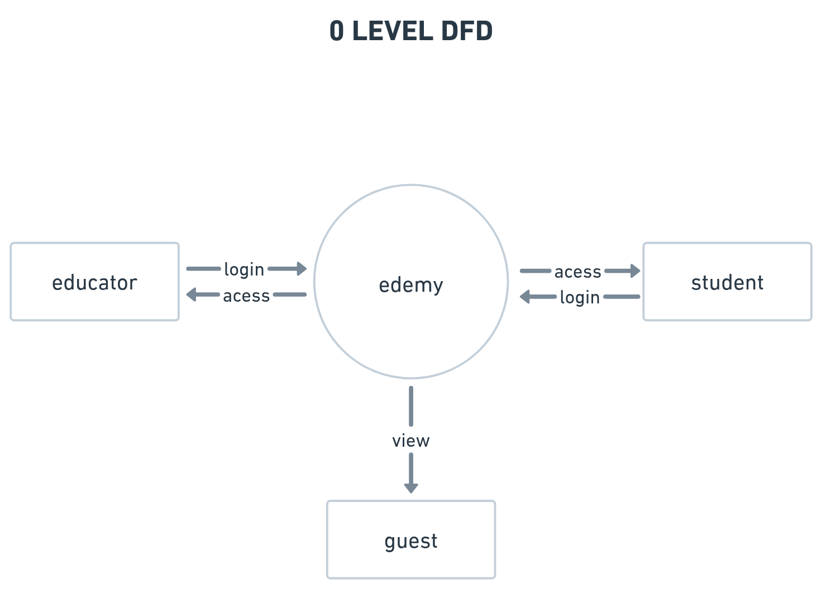
0-LEVEL DFD

Slide 9
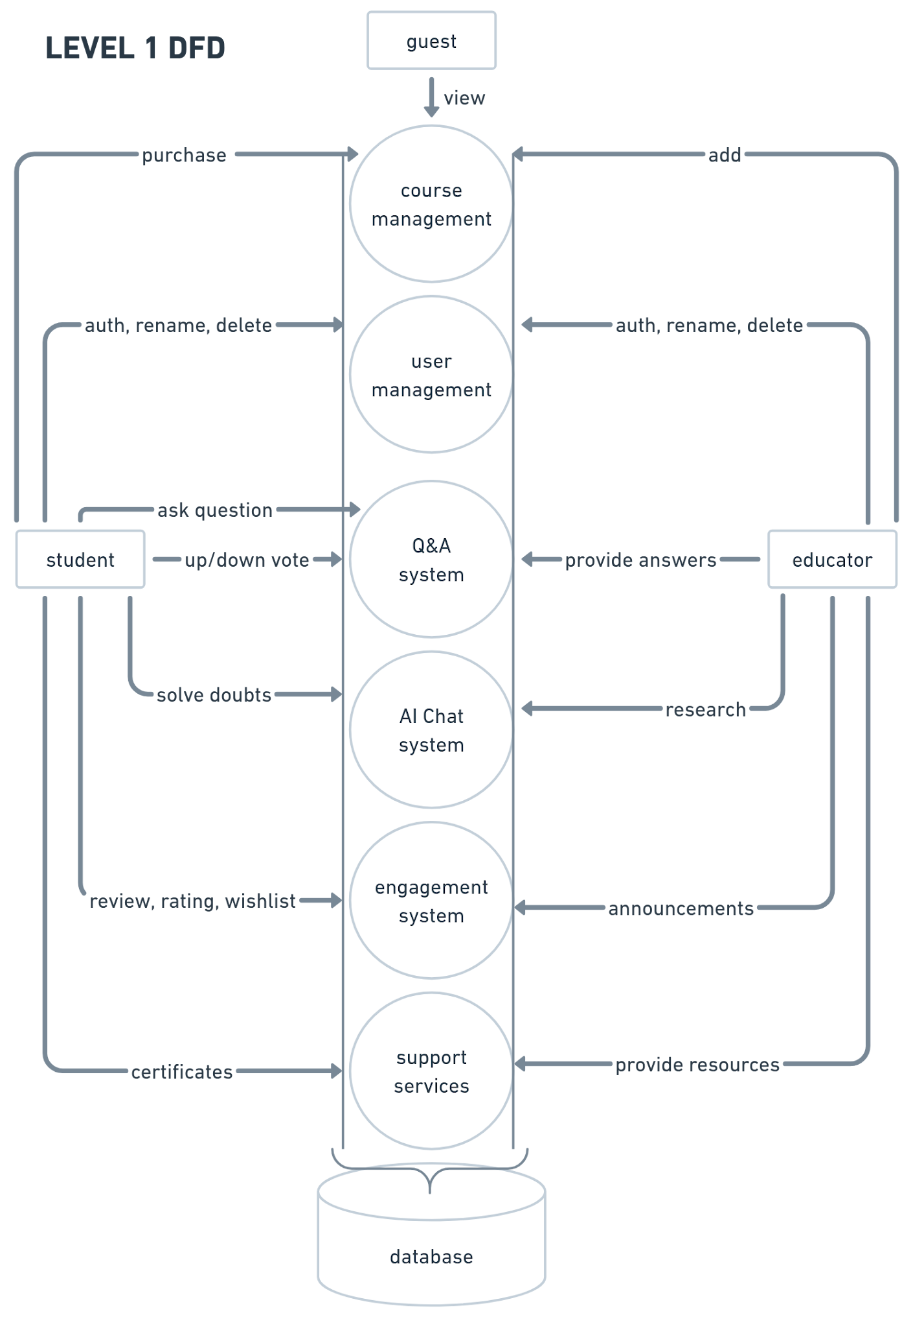

Slide 10
ER DIAGRAM

Slide 11
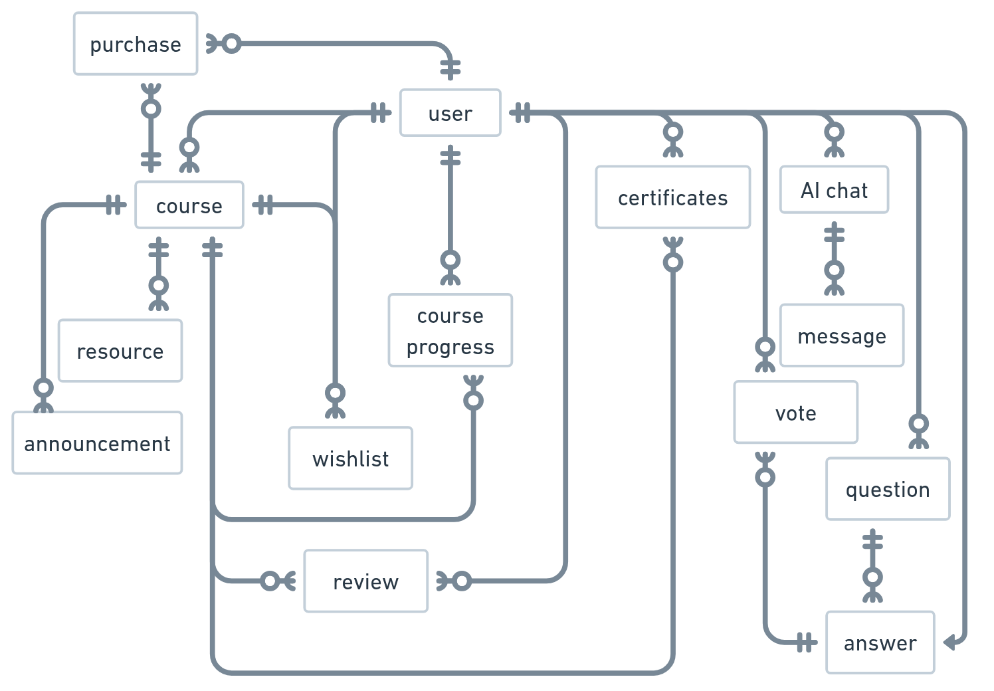

Slide 12
DATABASE DESIGN

Slide 13
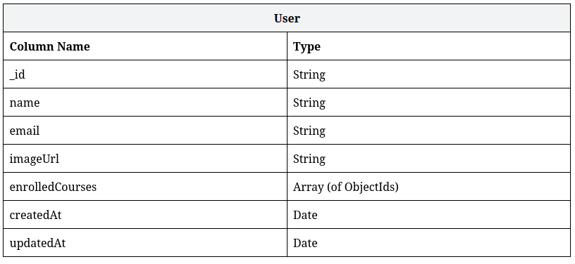
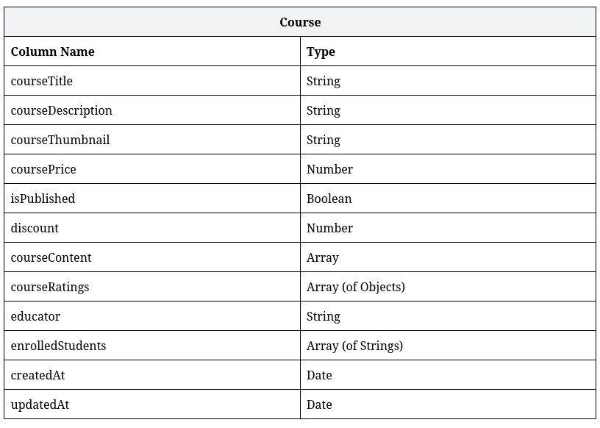

Slide 14
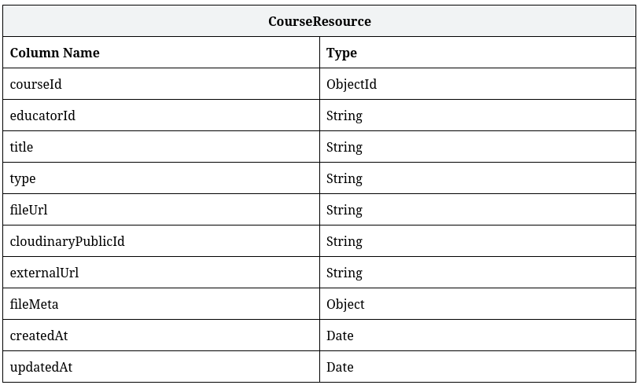
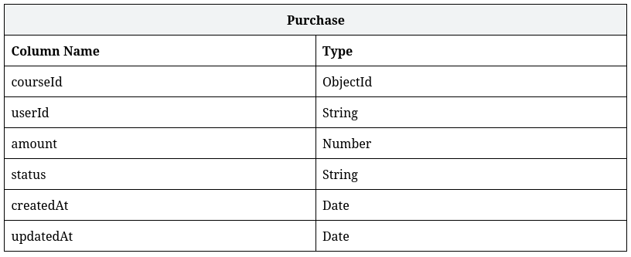

Slide 15
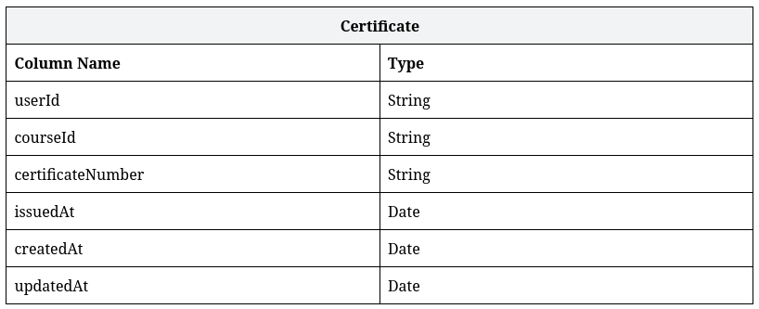
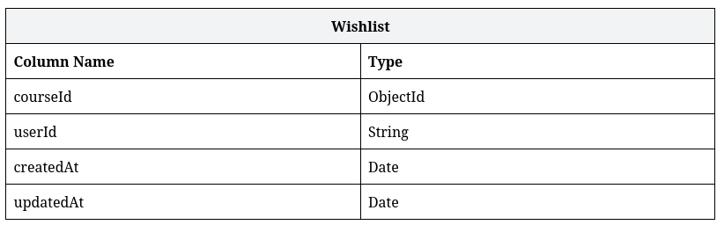
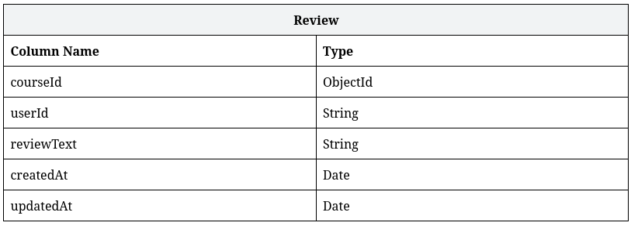

Slide 16
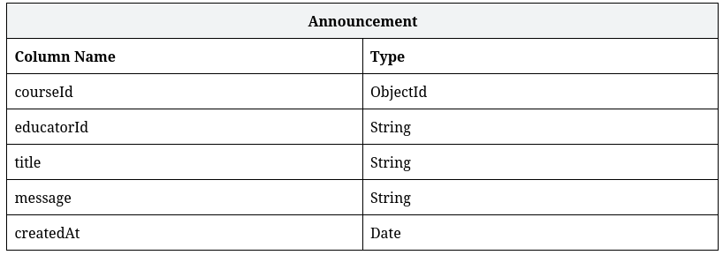
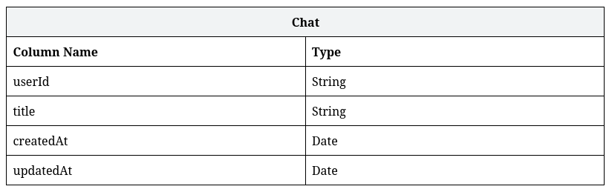
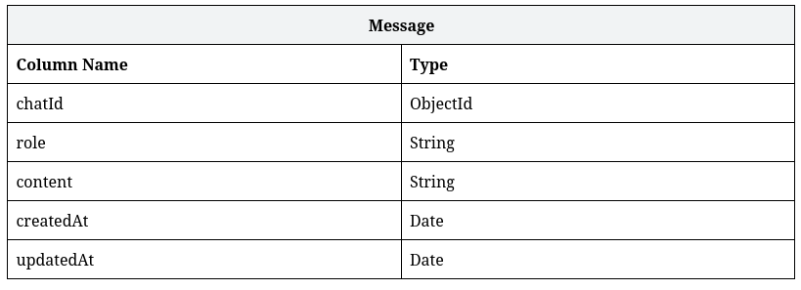

Slide 17
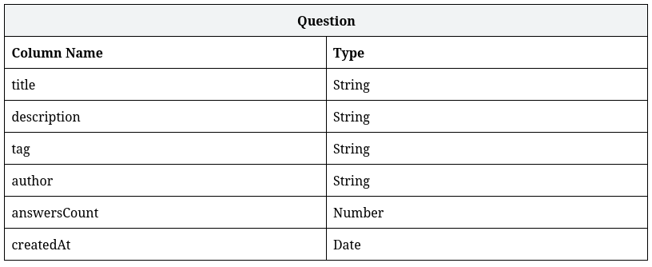
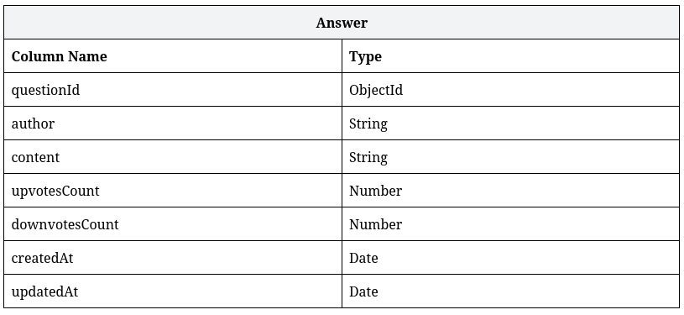
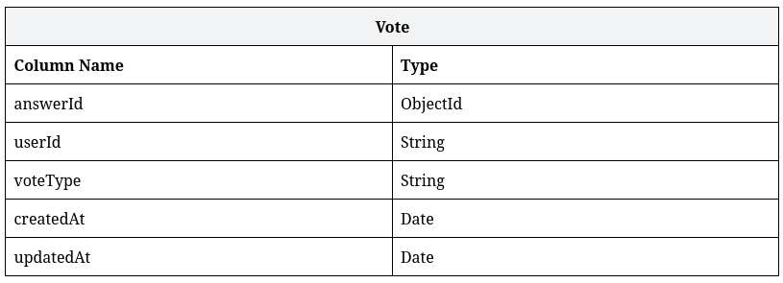

Slide 18
IMPLEMENTATION DETAILS

Slide 19
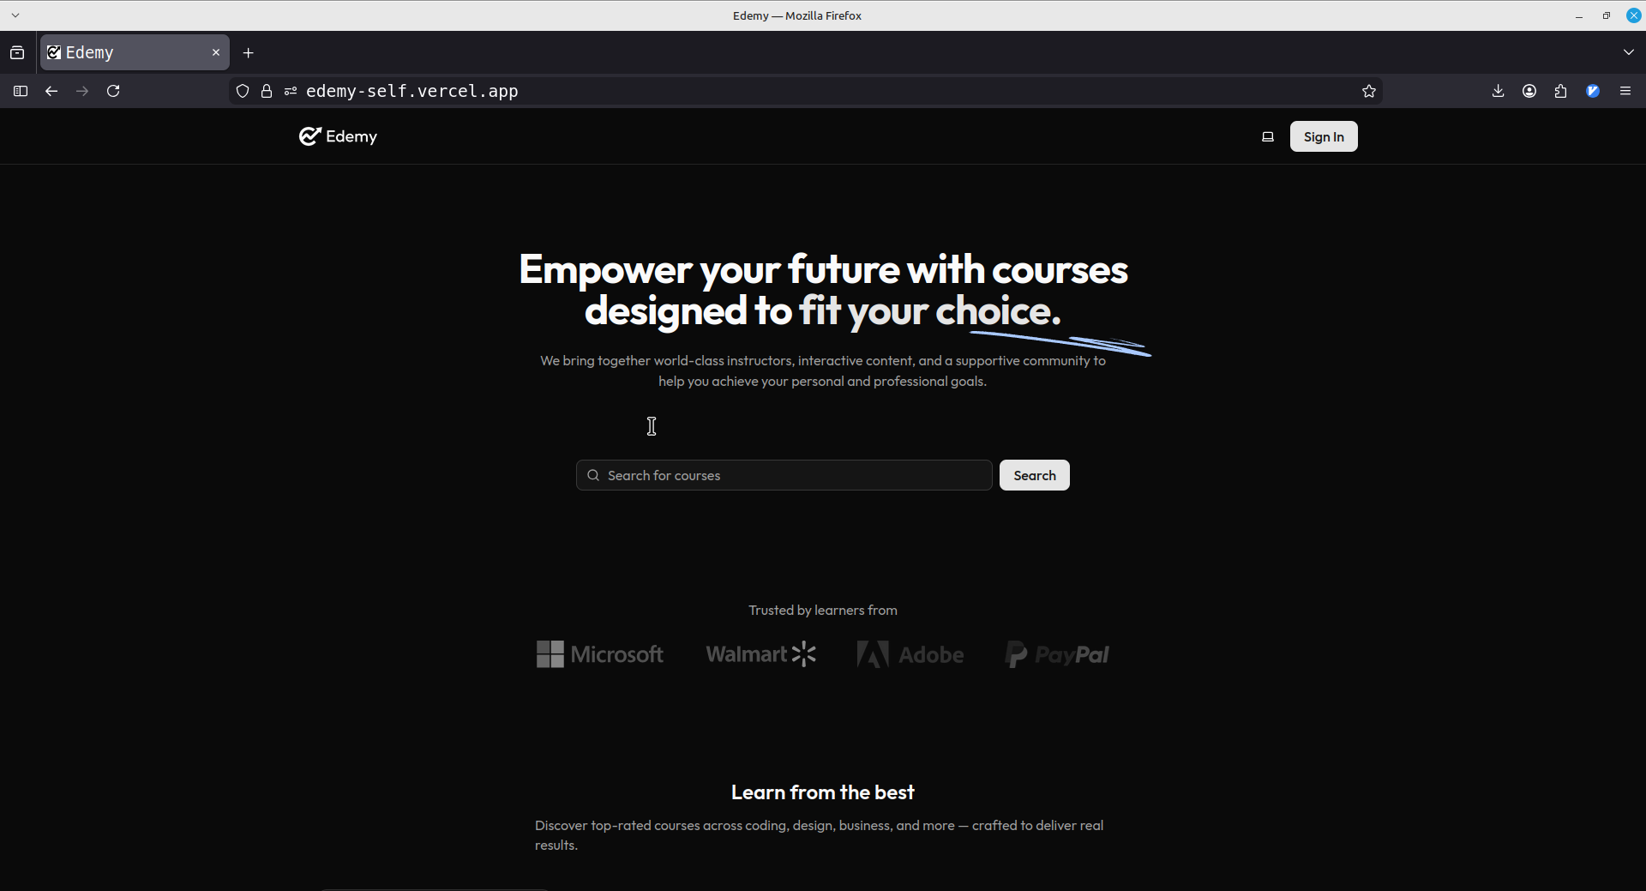

Slide 20
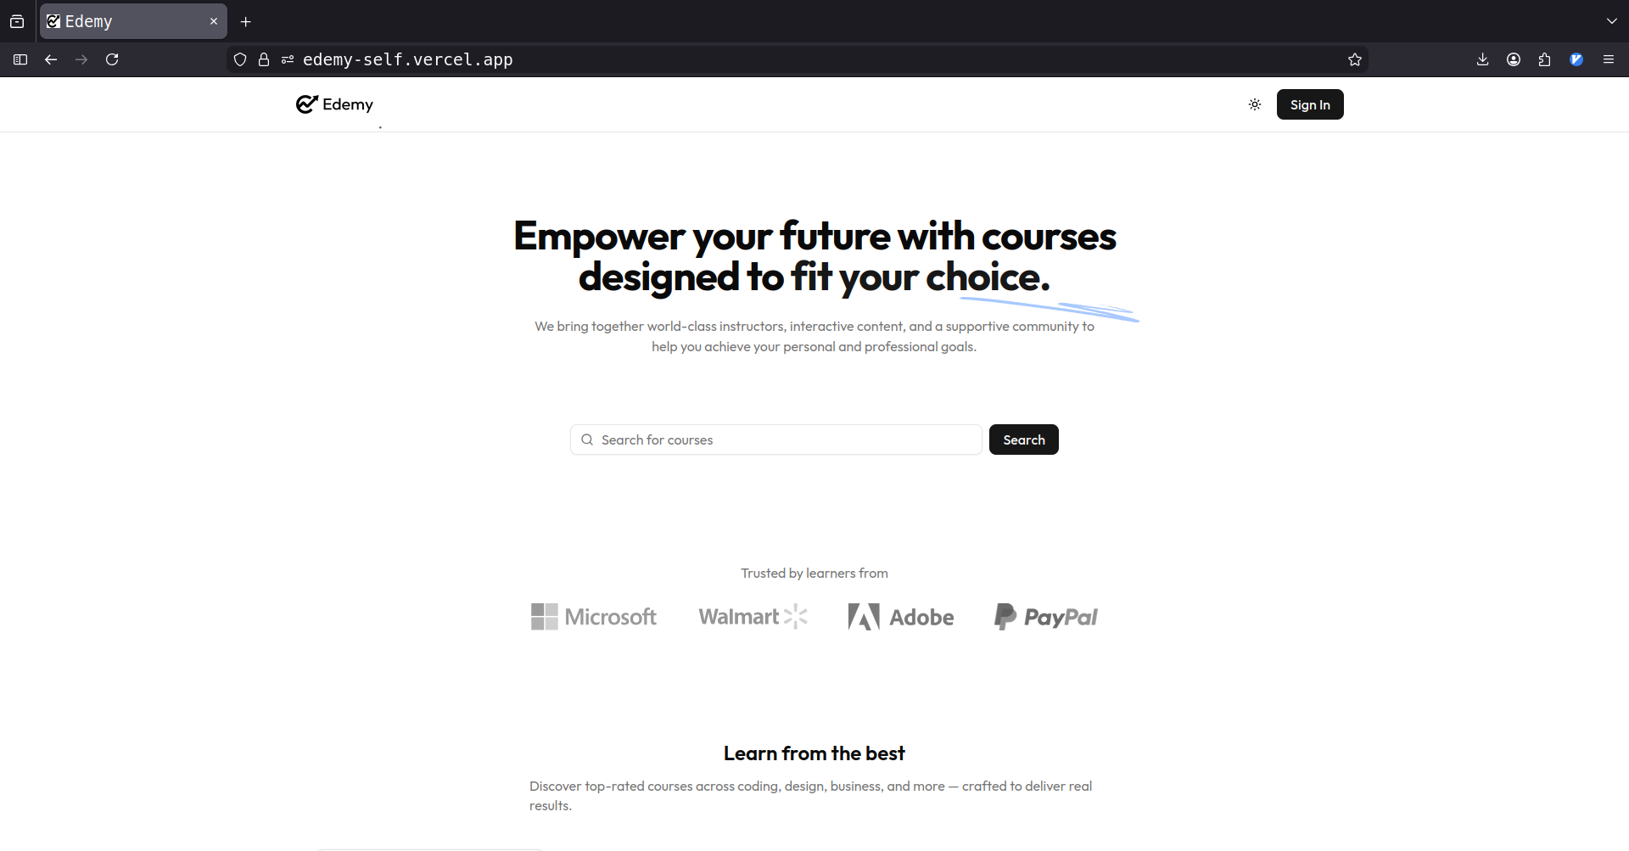

Slide 22
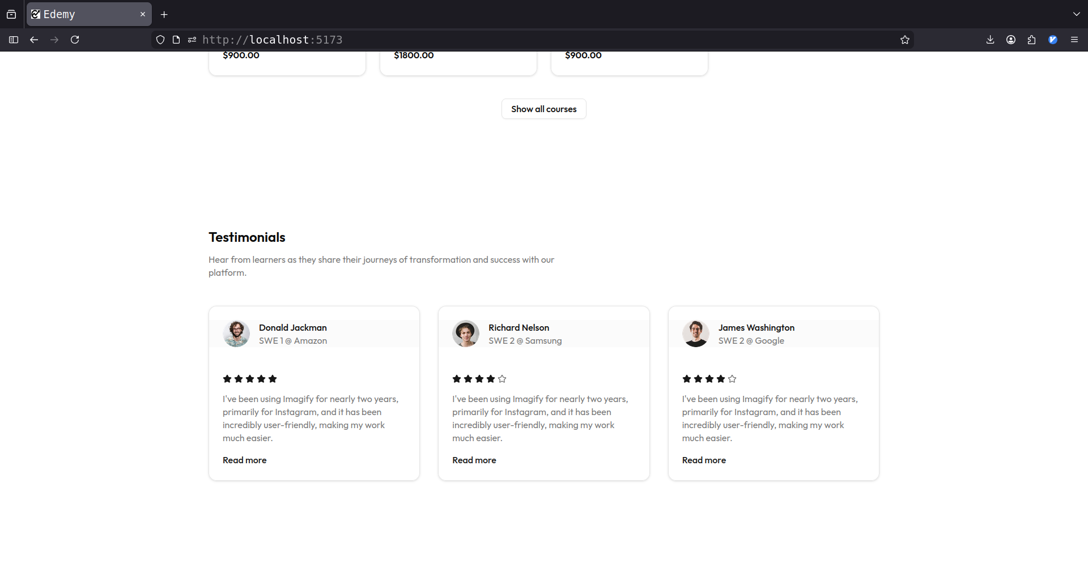

Slide 23
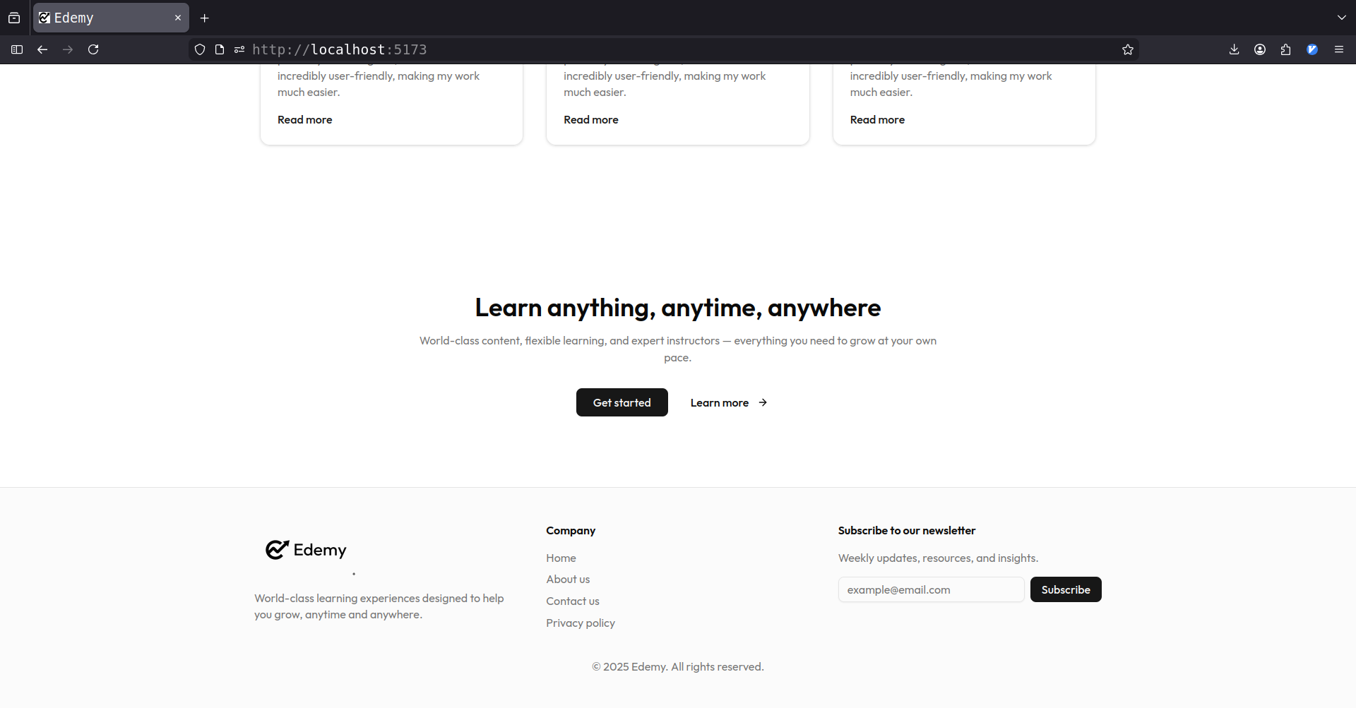

Slide 24
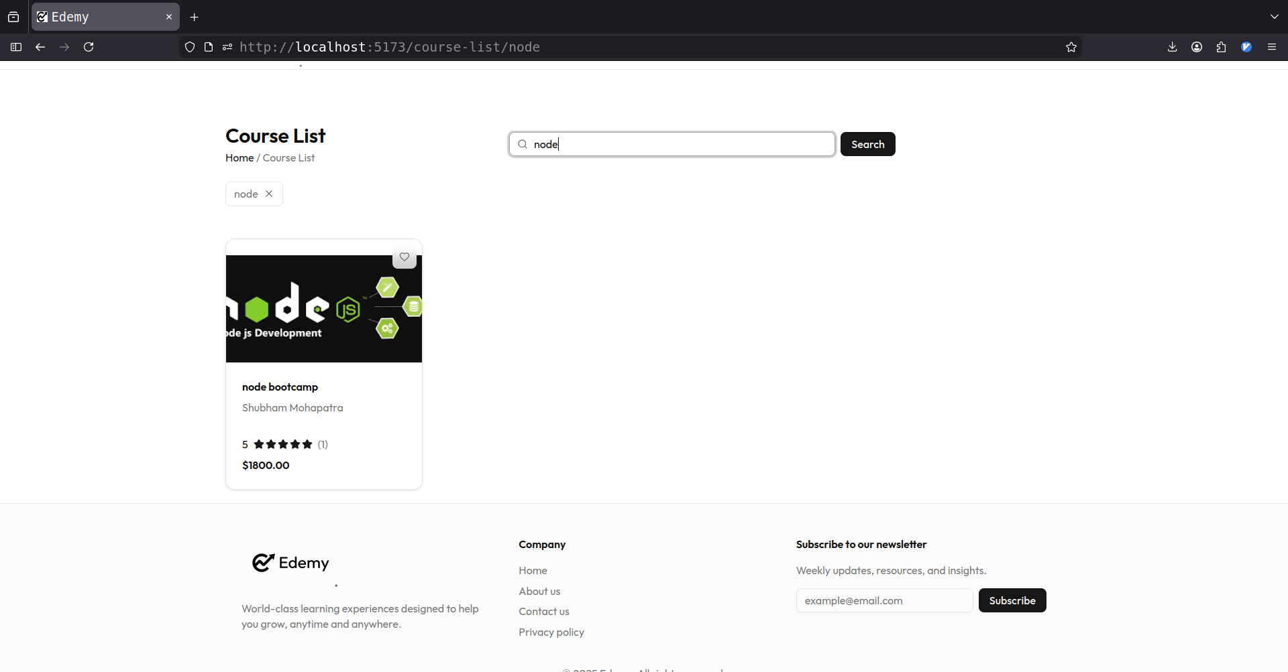

Slide 25
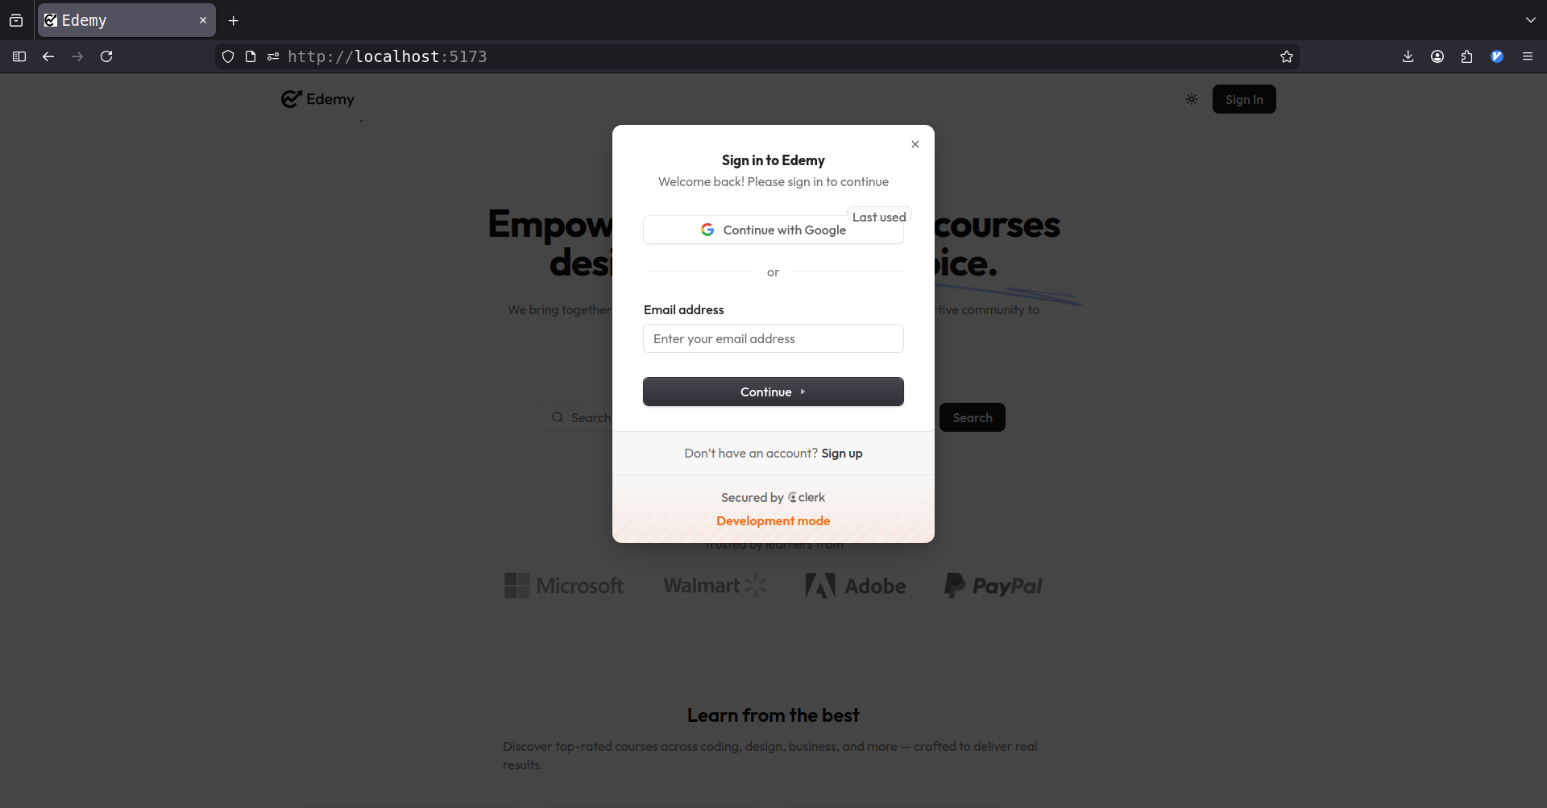

Slide 26
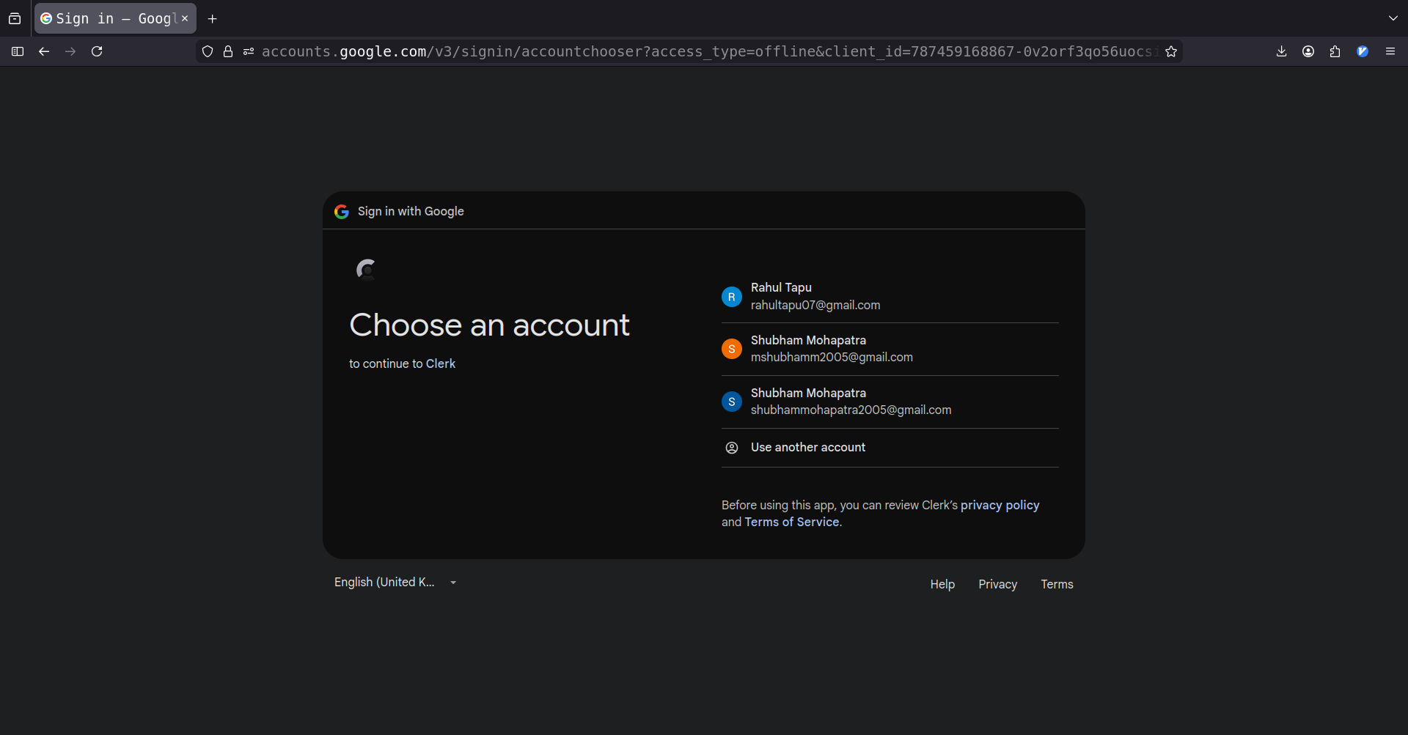

Slide 27
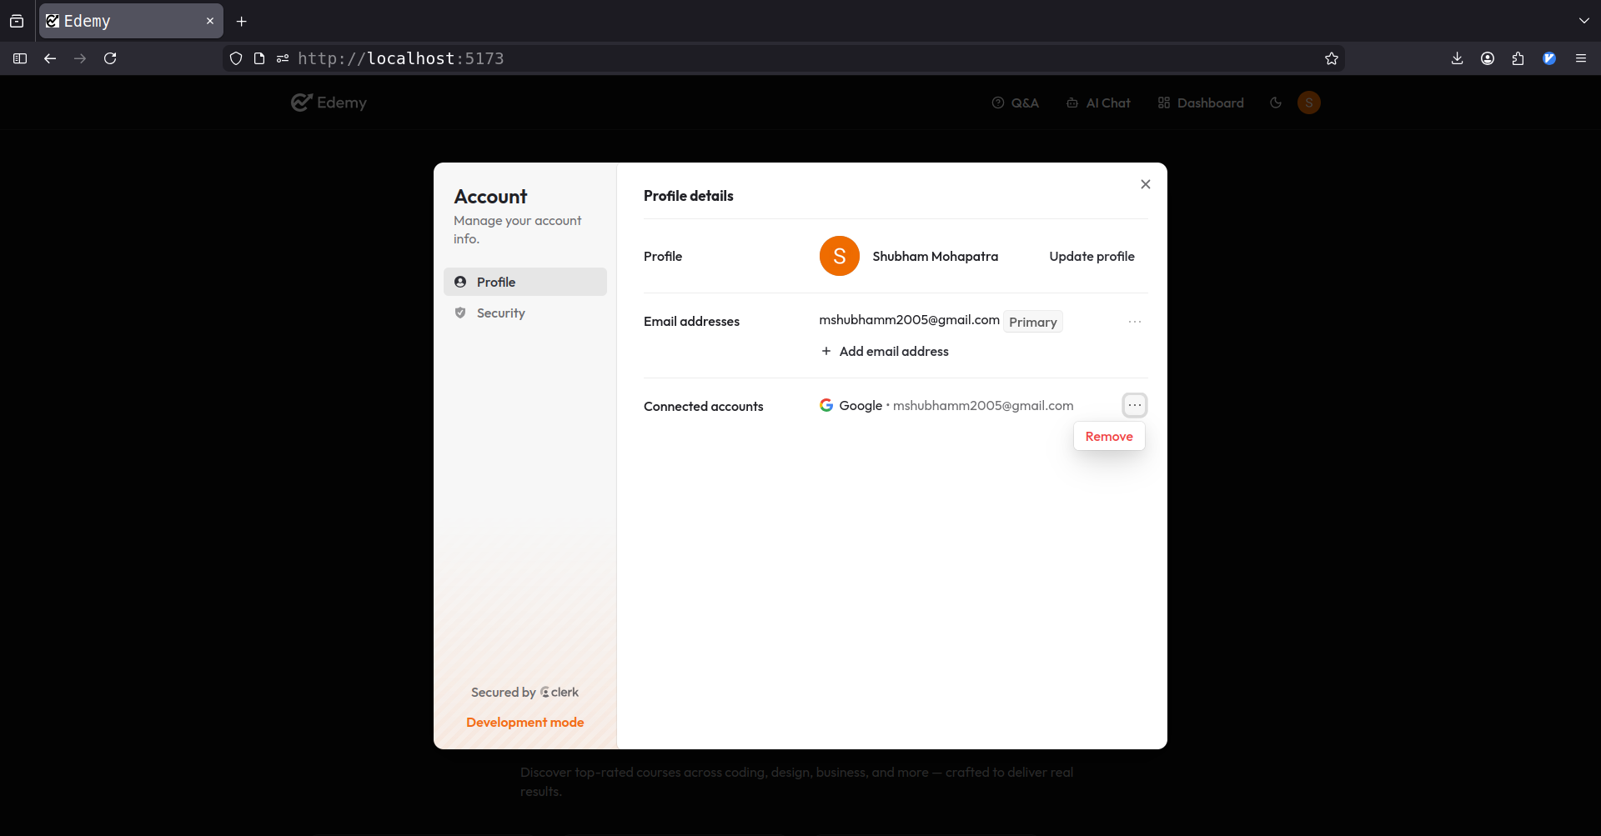

Slide 28
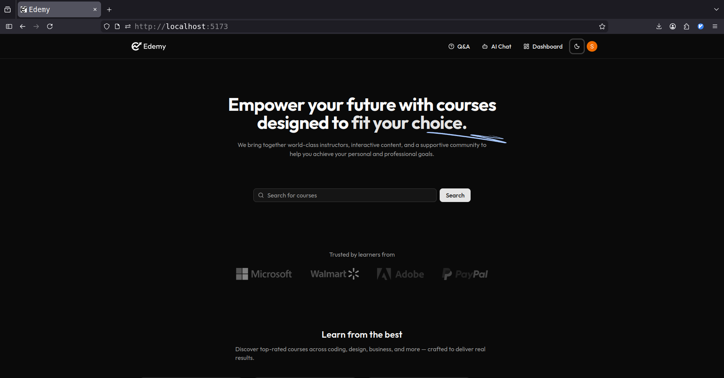

Slide 29
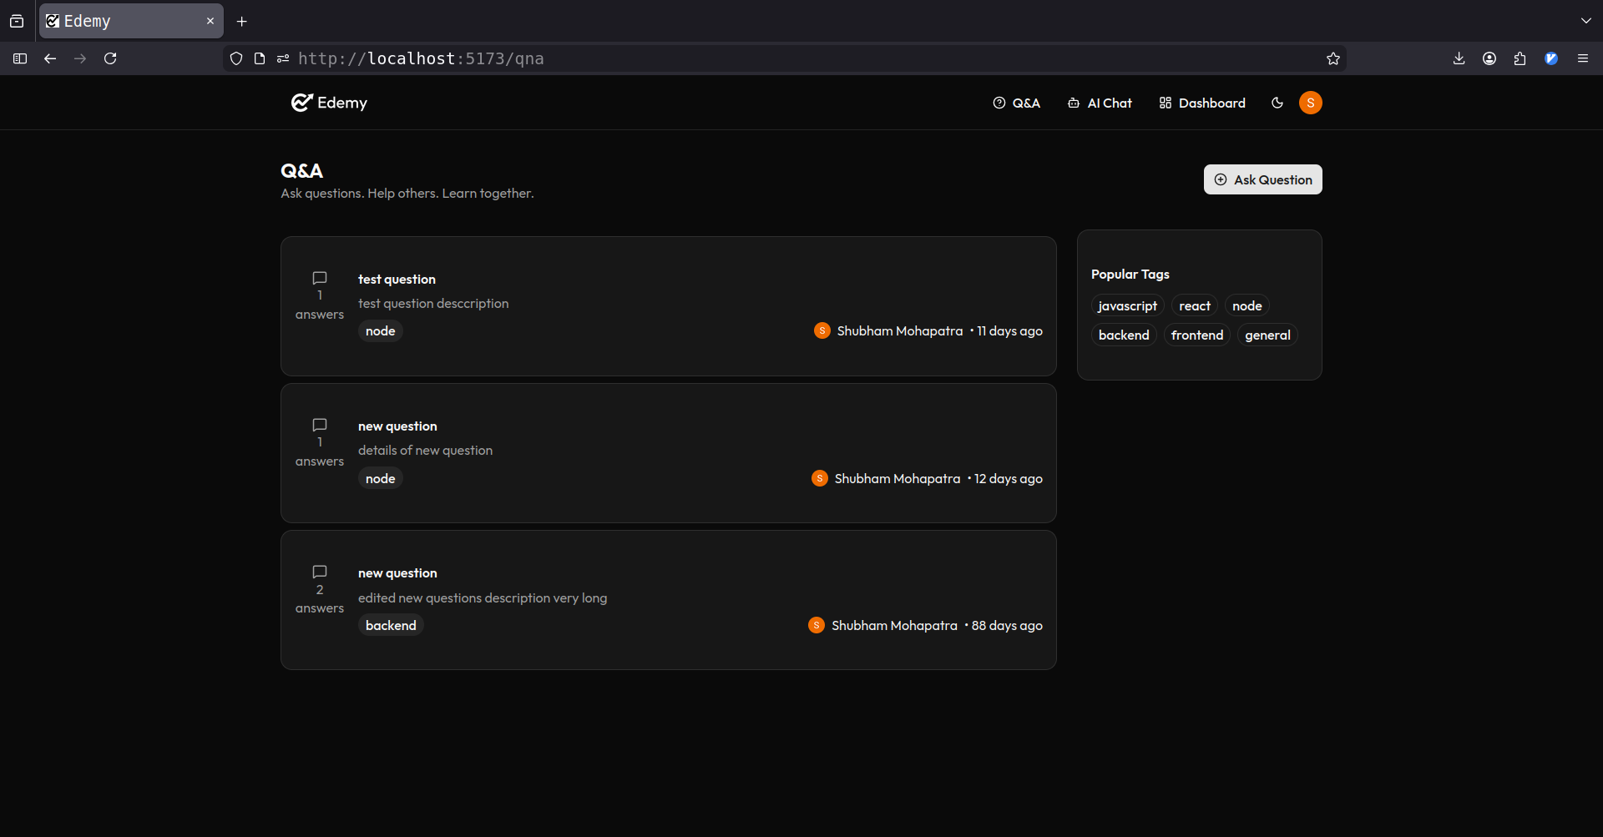

Slide 30
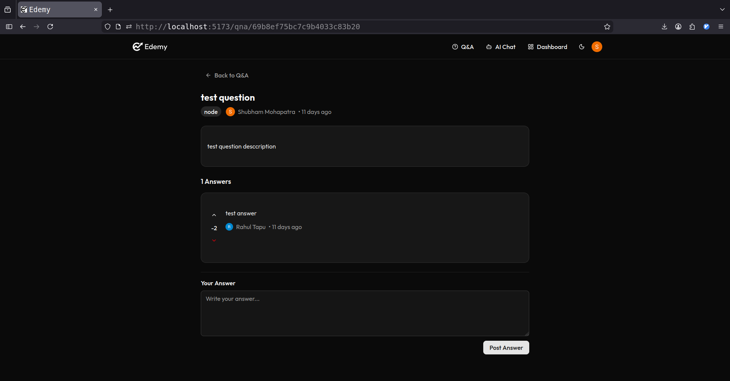

Slide 31
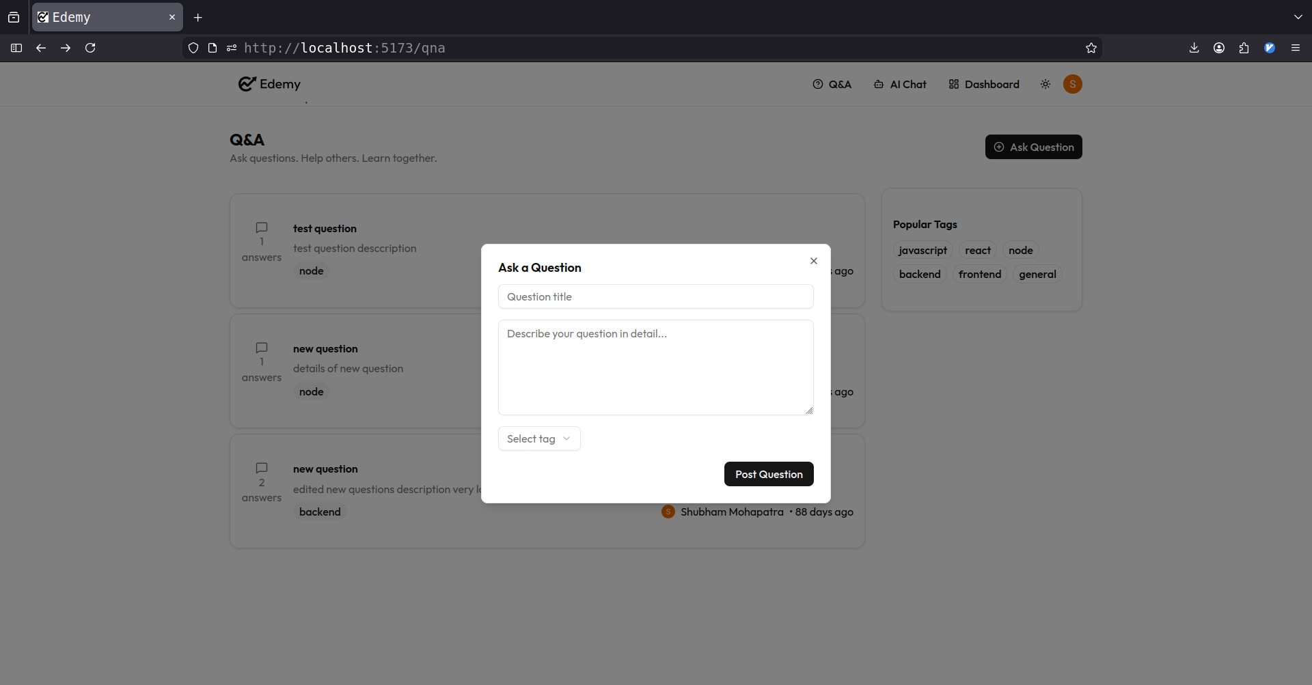

Slide 32
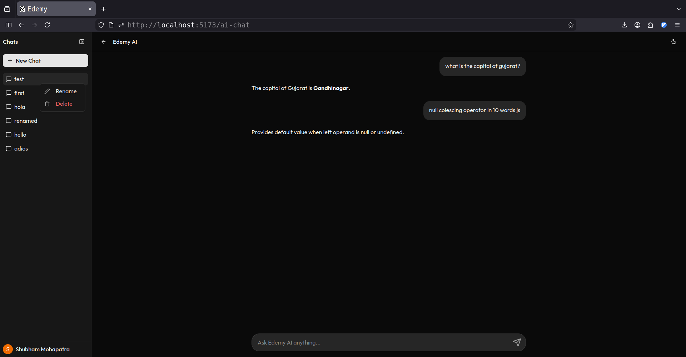

Slide 33
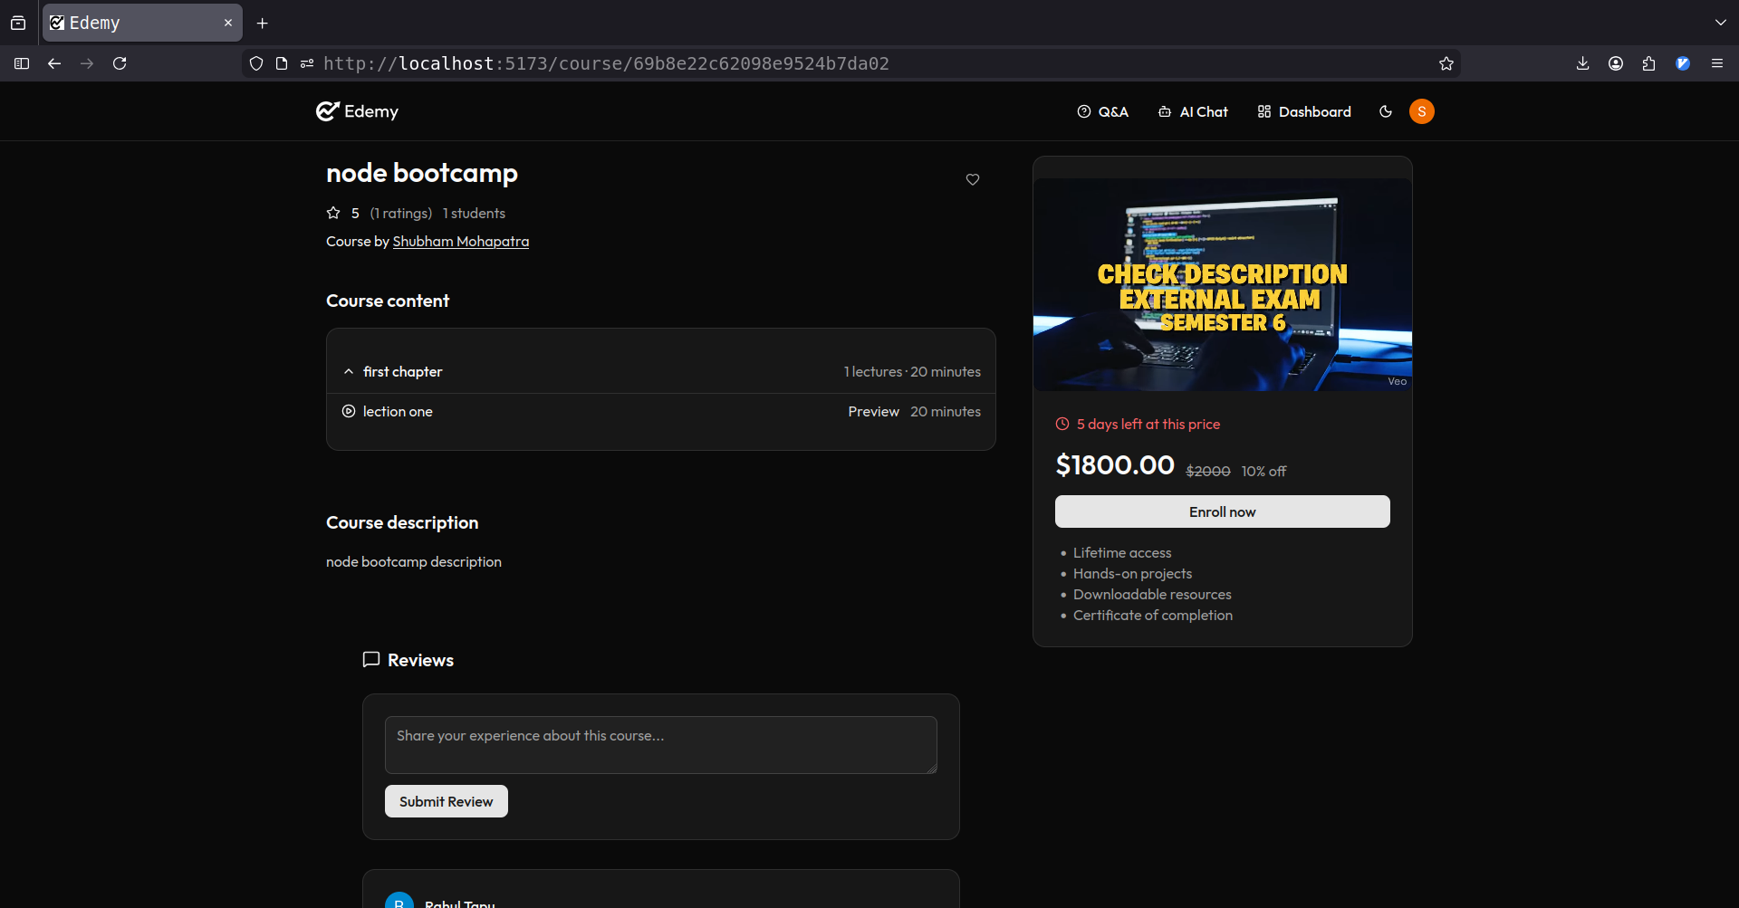

Slide 34
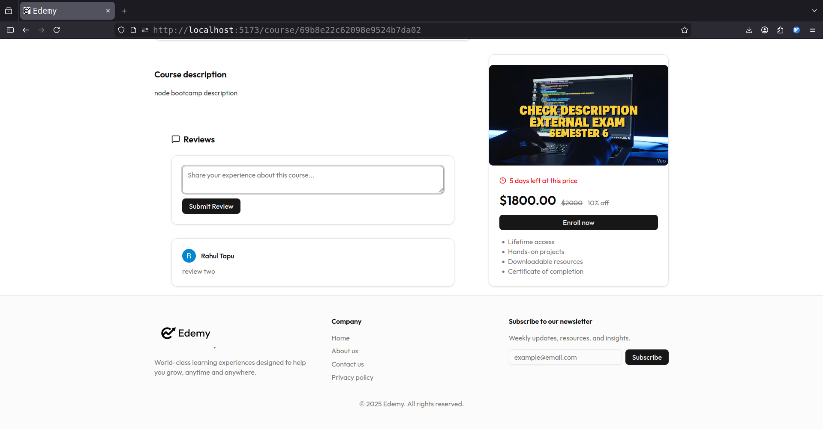

Slide 35
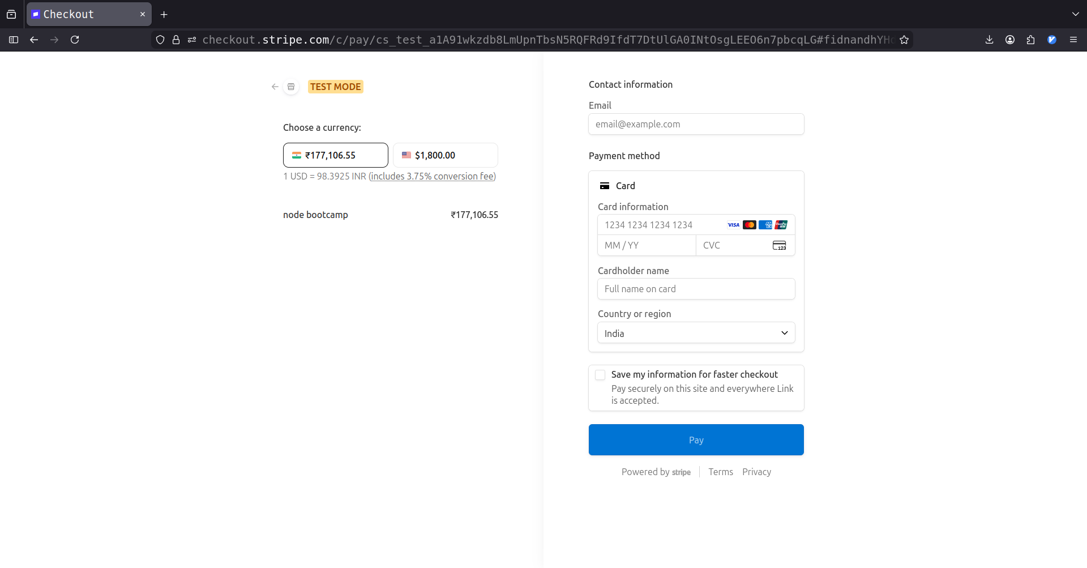

Slide 36
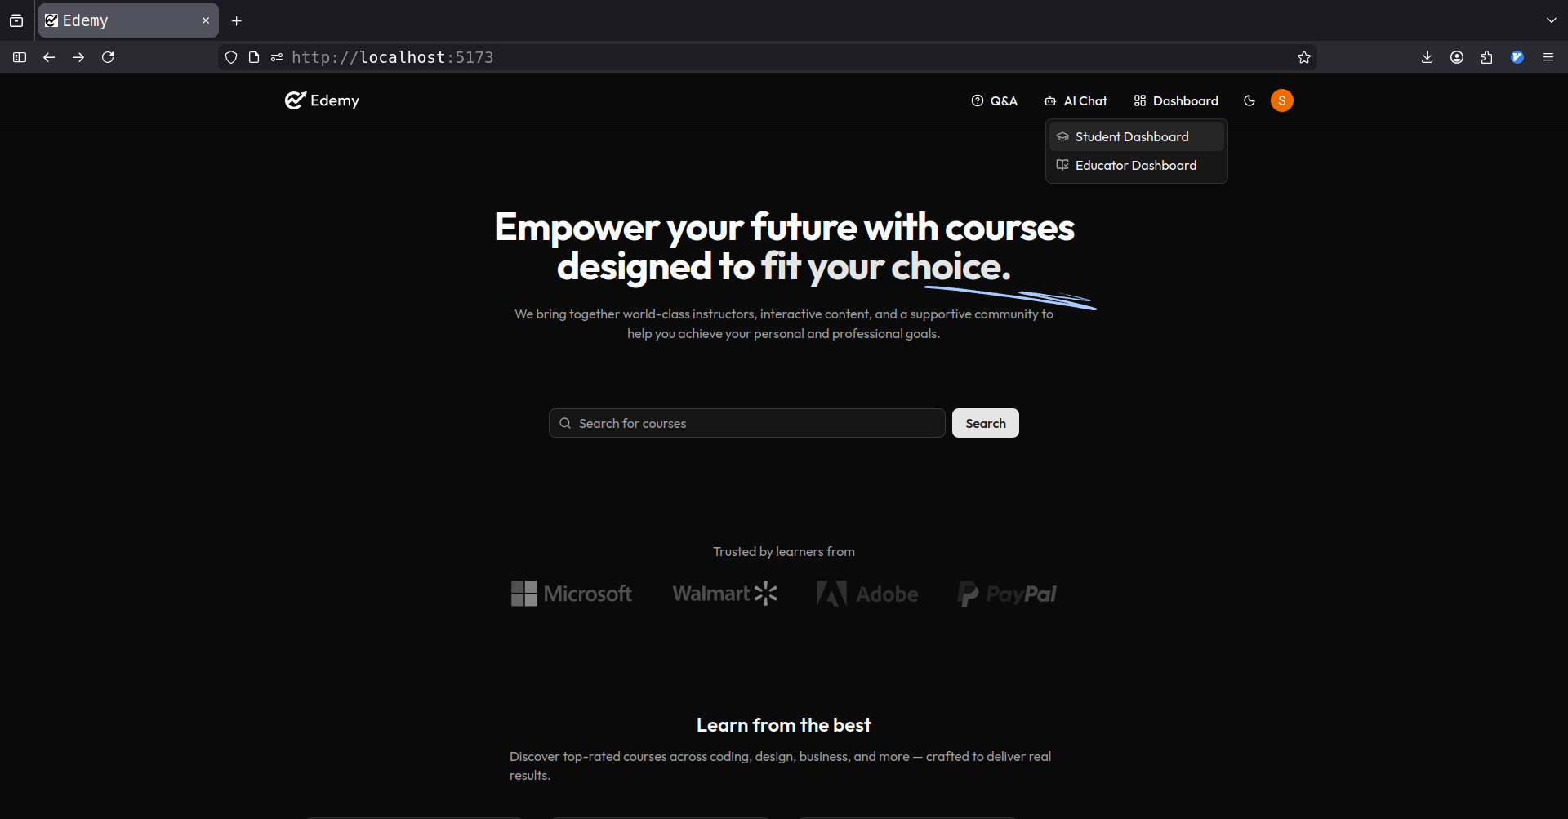

Slide 37
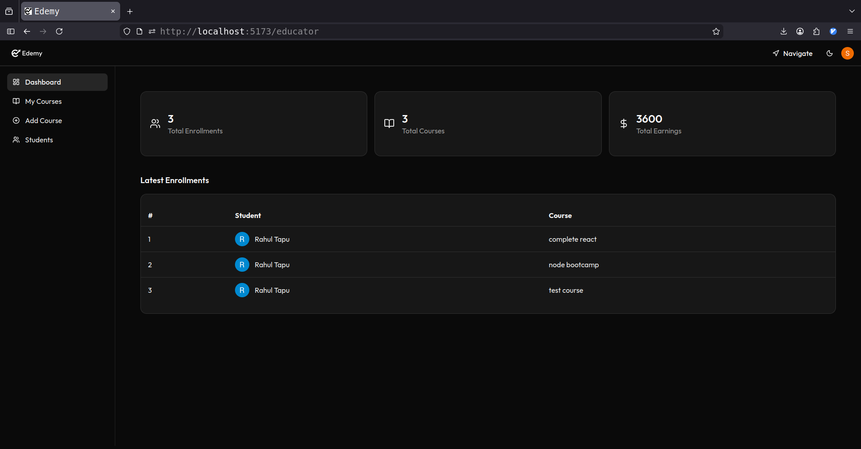

Slide 38
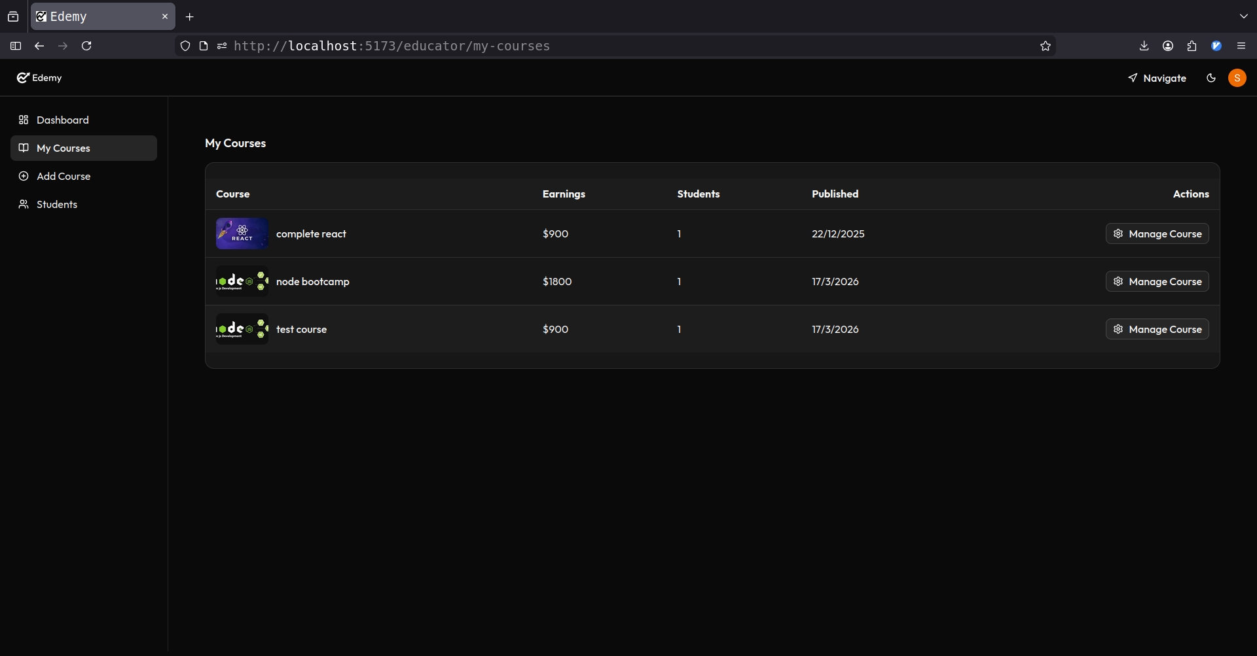

Slide 39
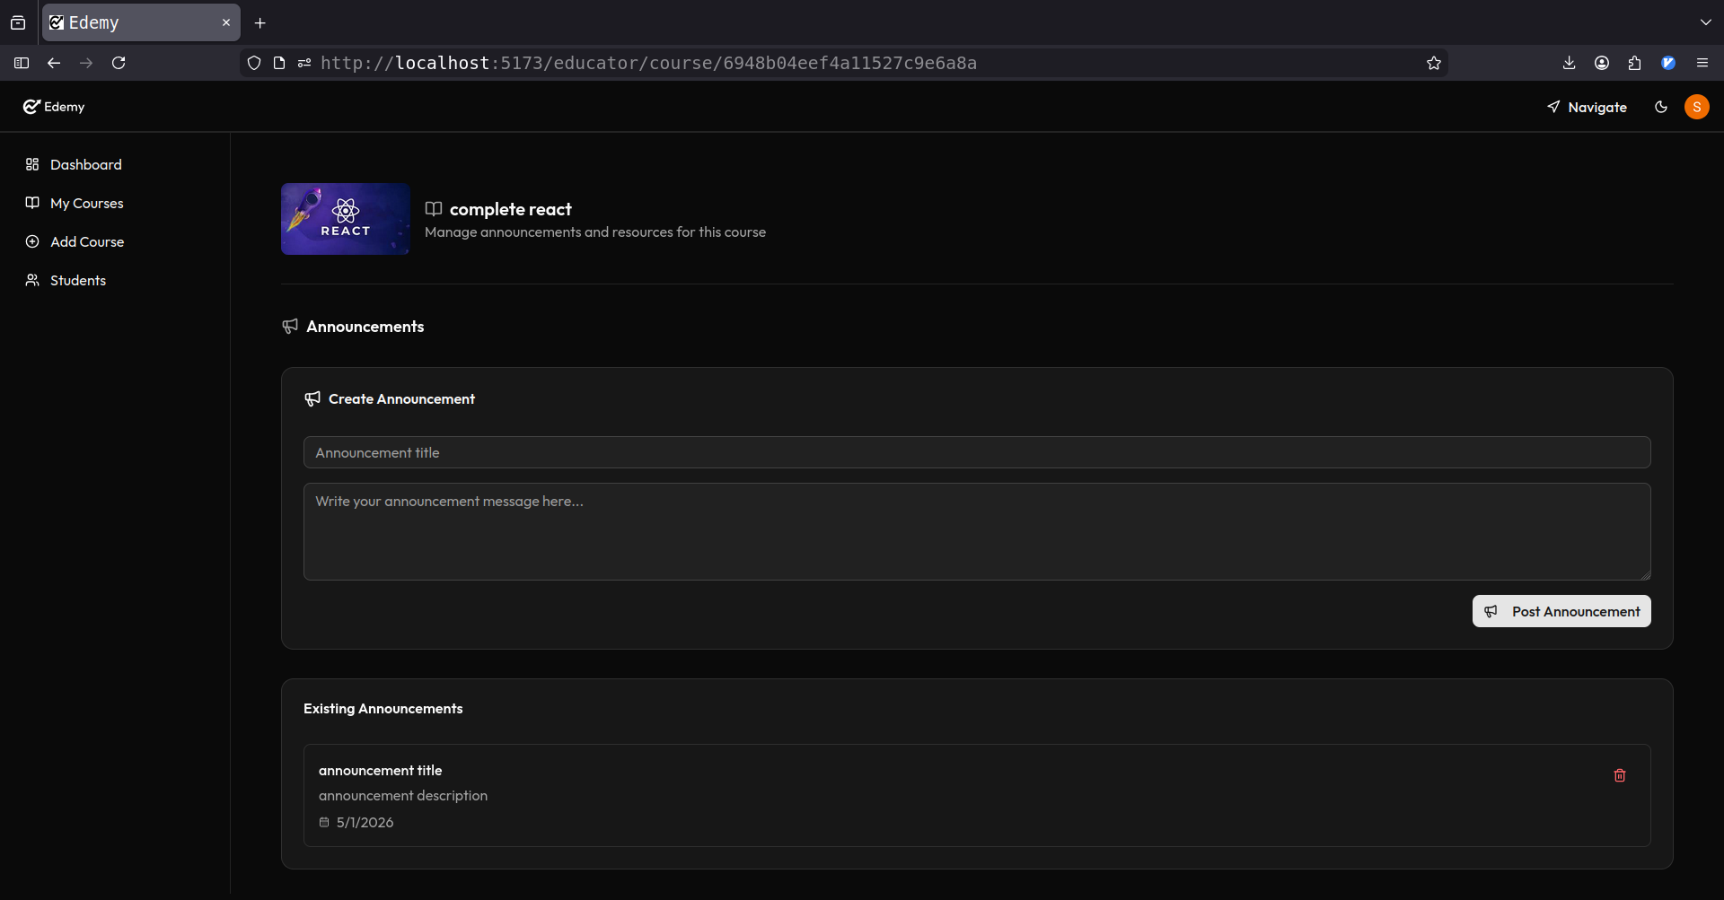

Slide 40
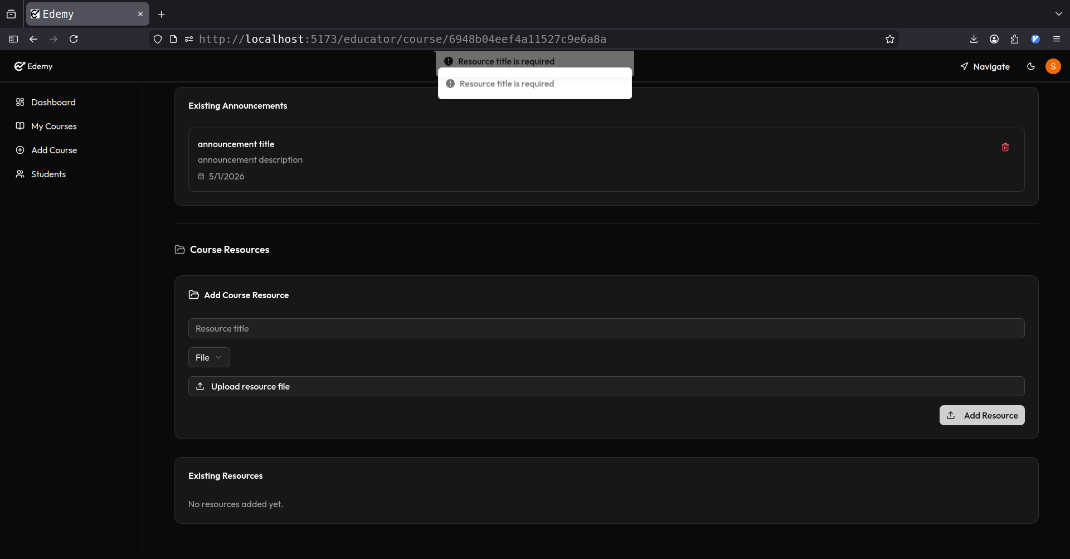

Slide 41
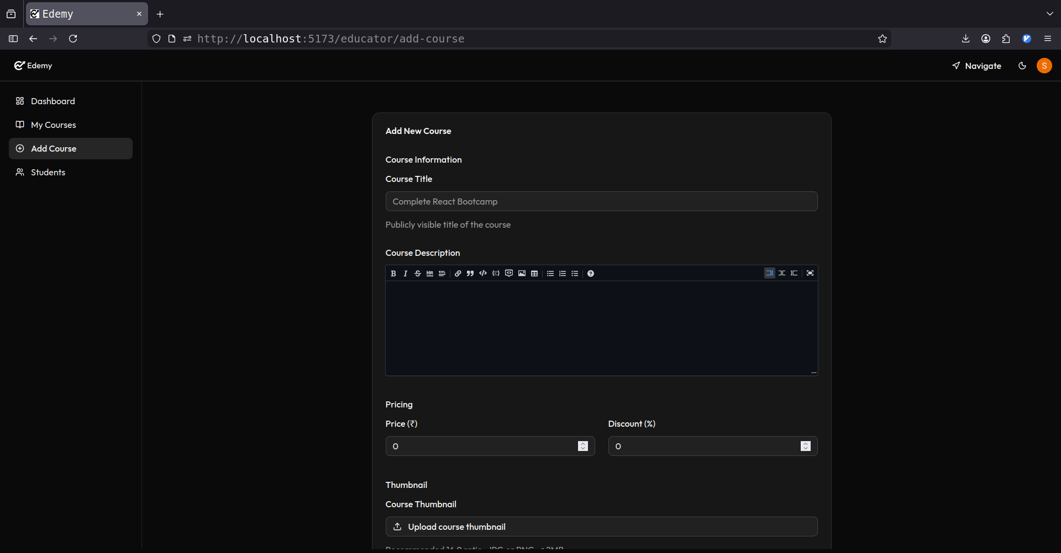

Slide 42
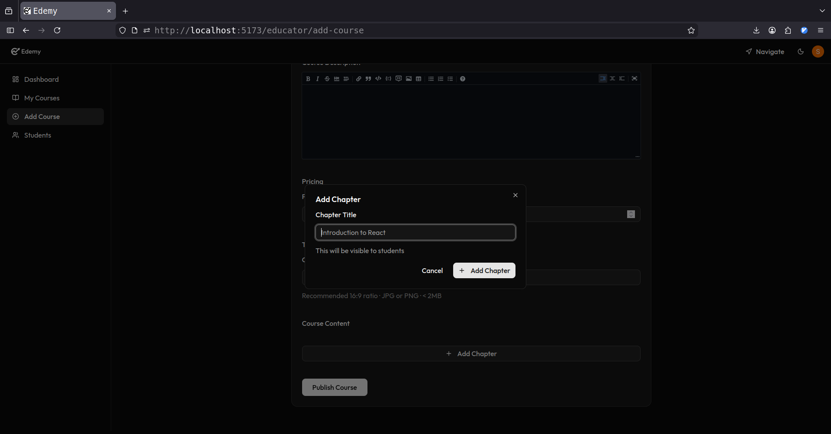

Slide 43
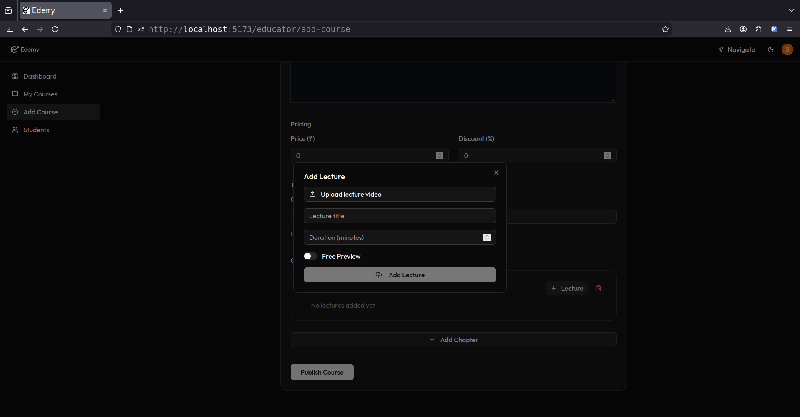

Slide 44
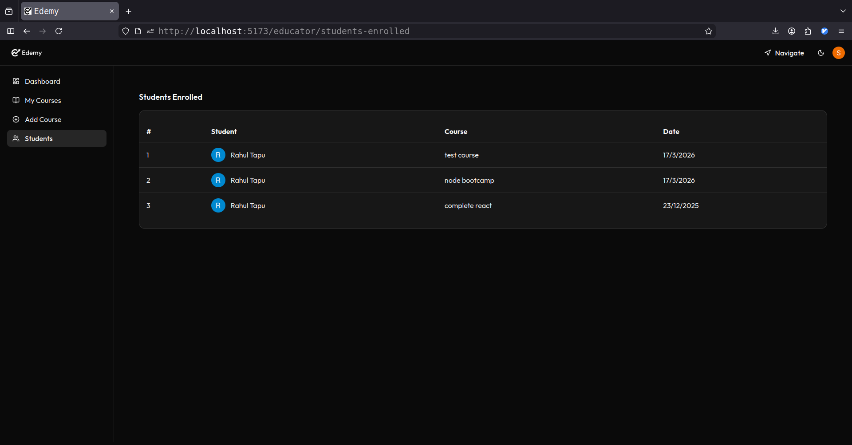

Slide 45
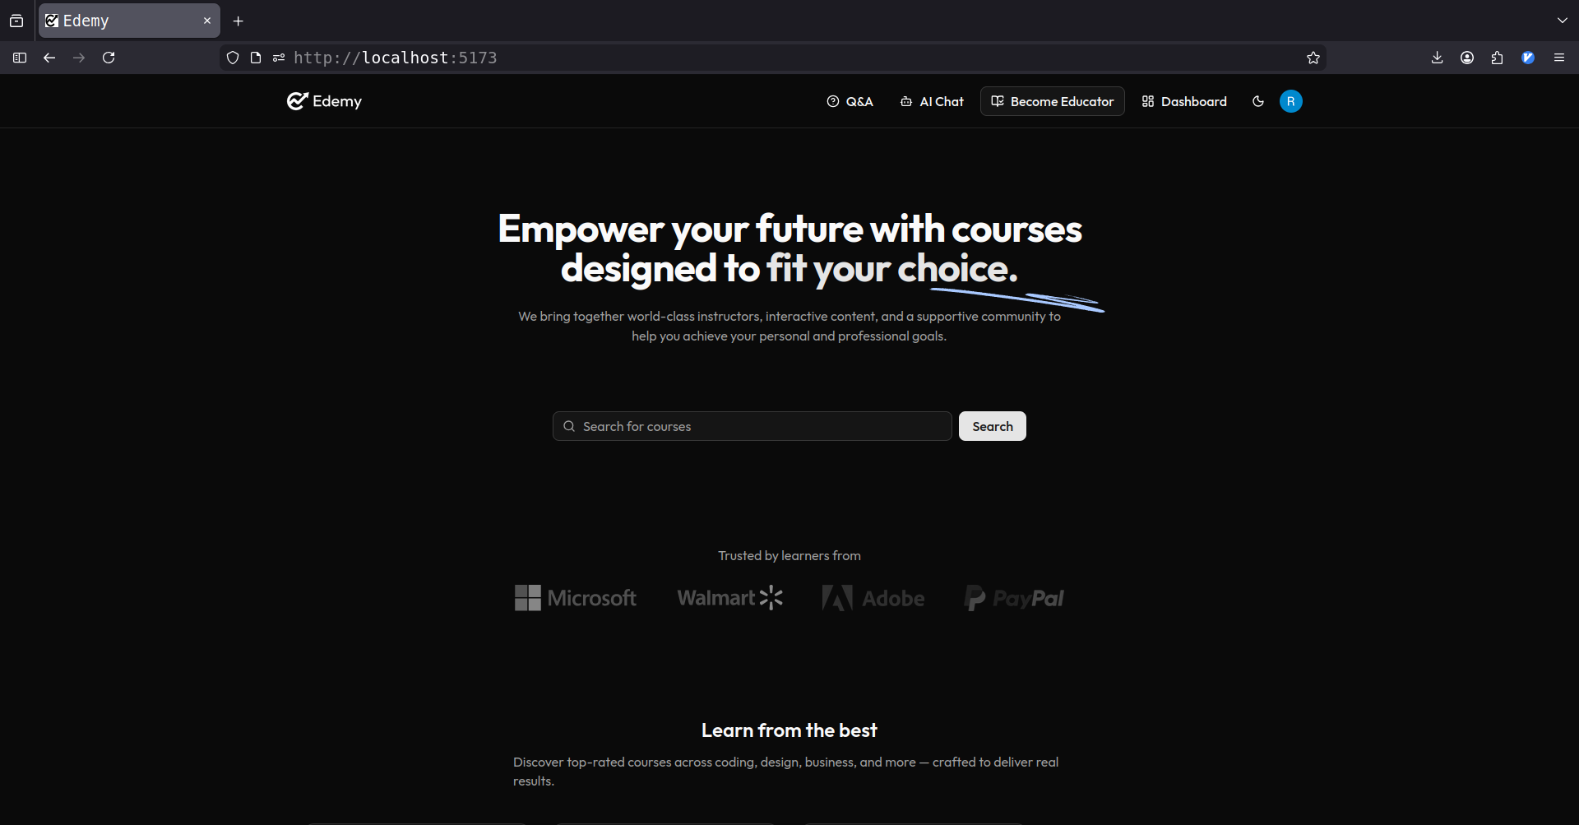

Slide 46
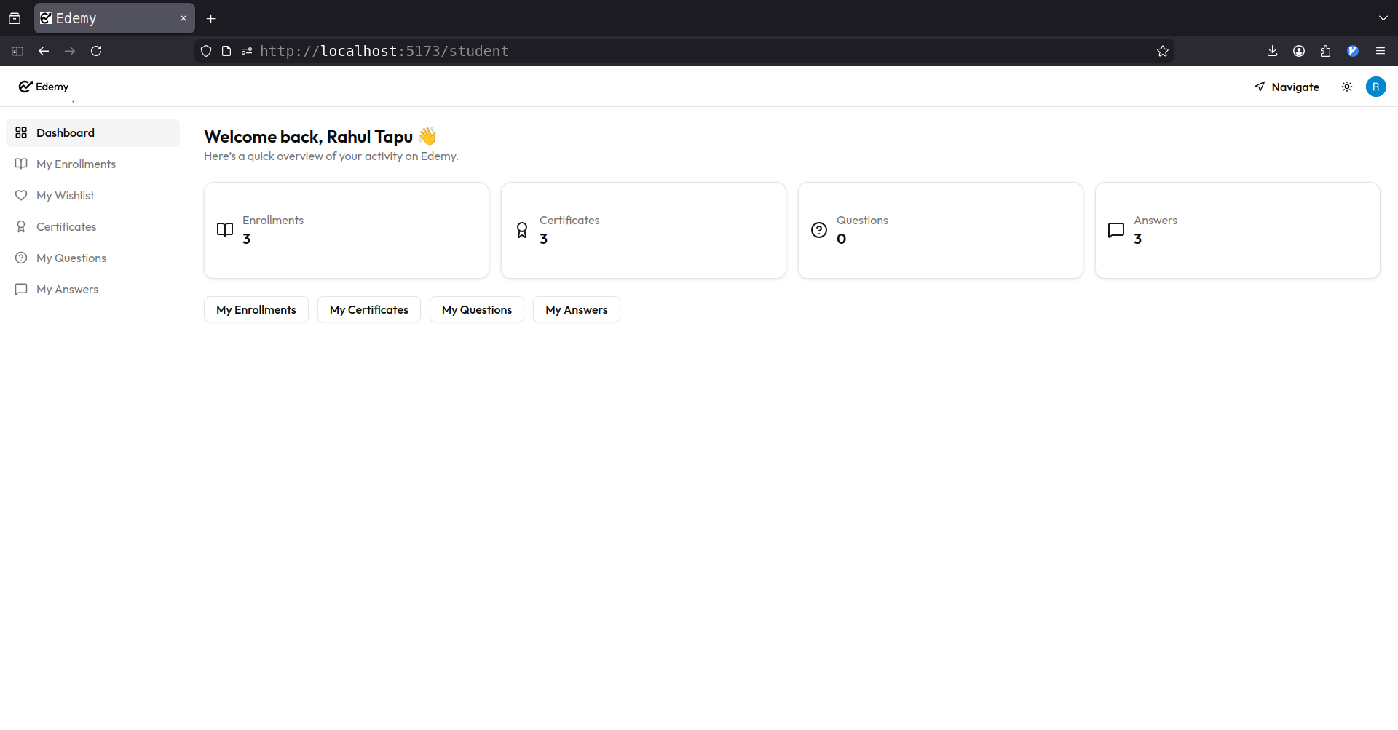

Slide 47
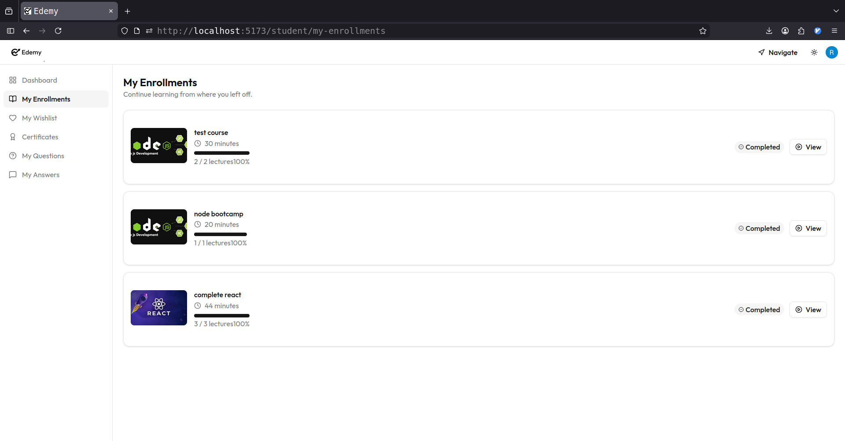

Slide 48
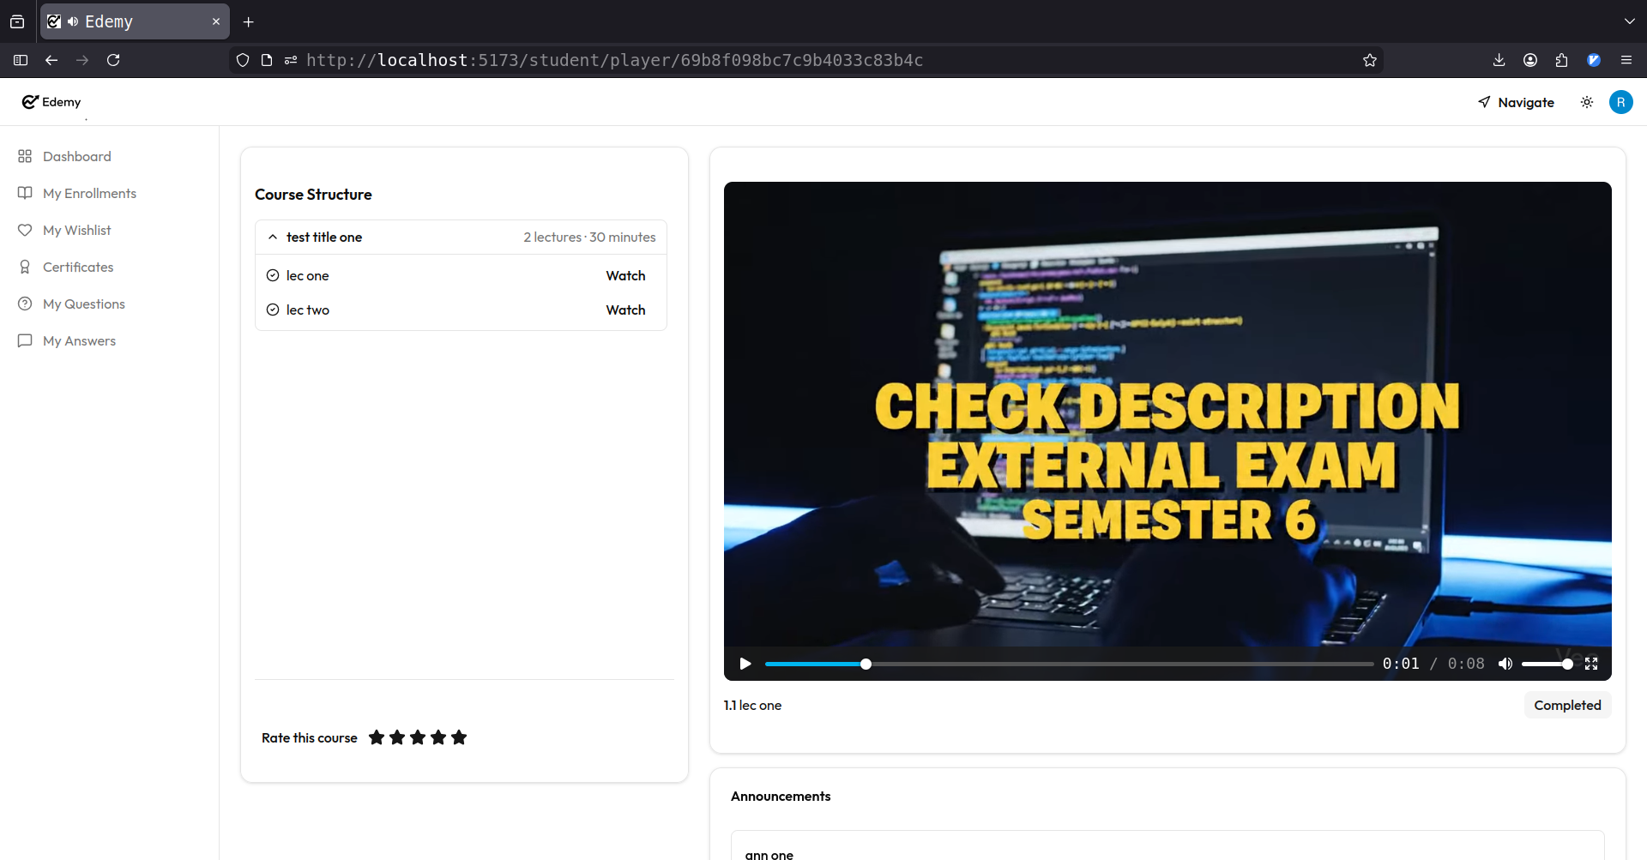

Slide 49
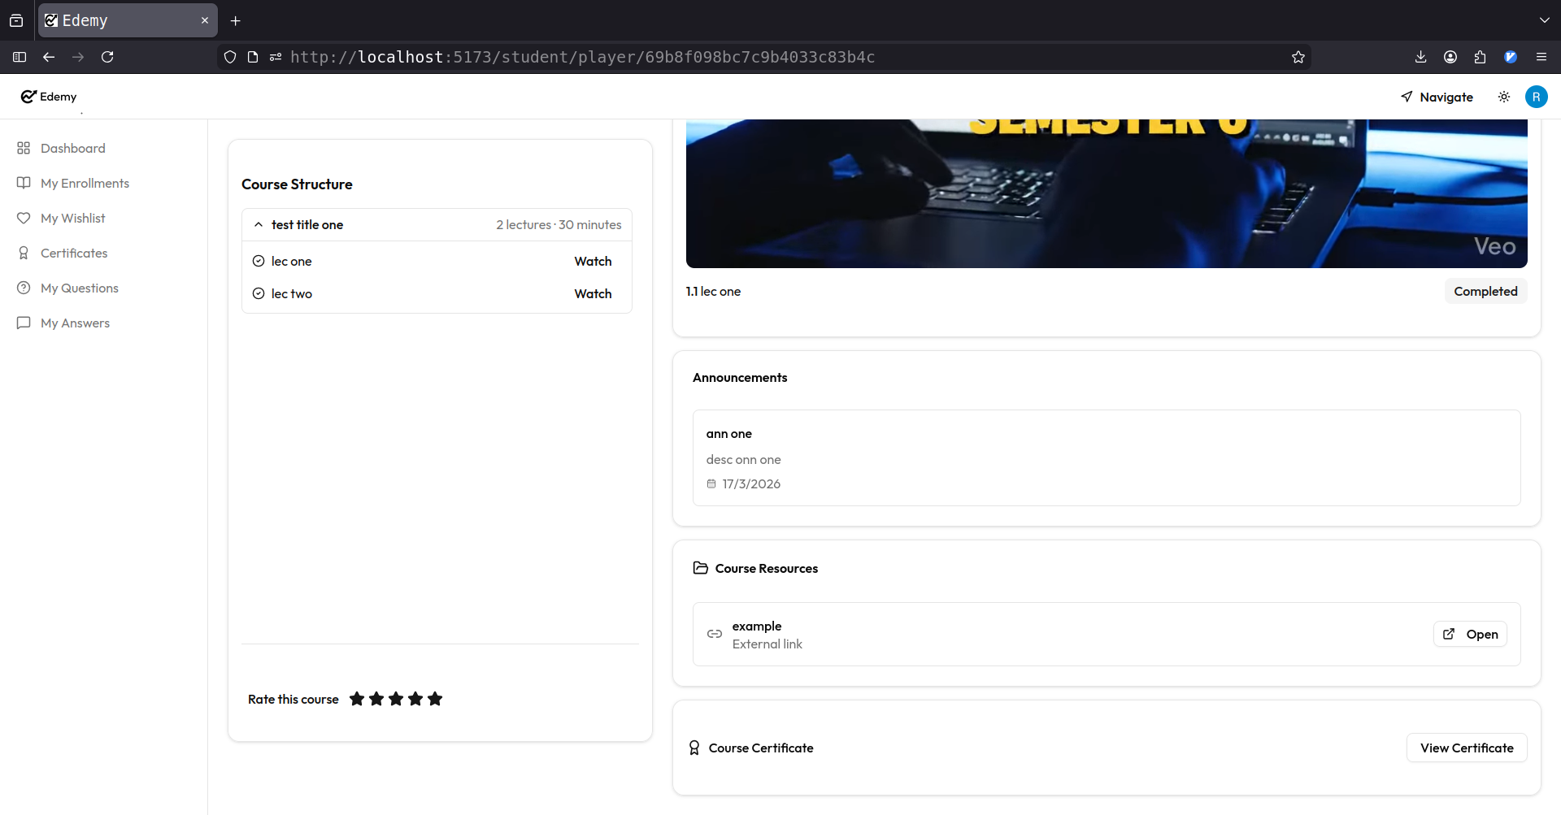

Slide 50
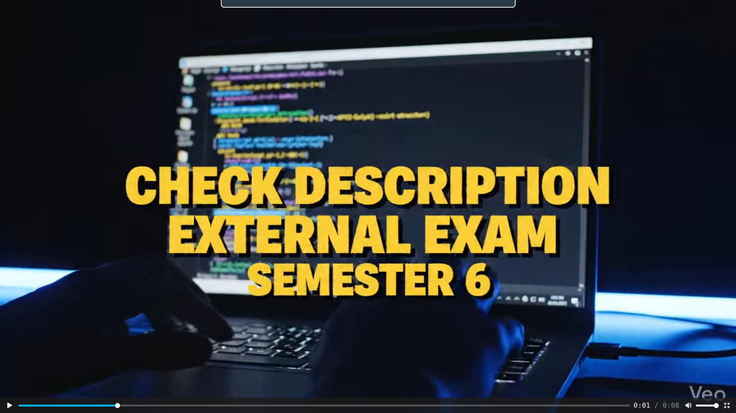

Slide 51
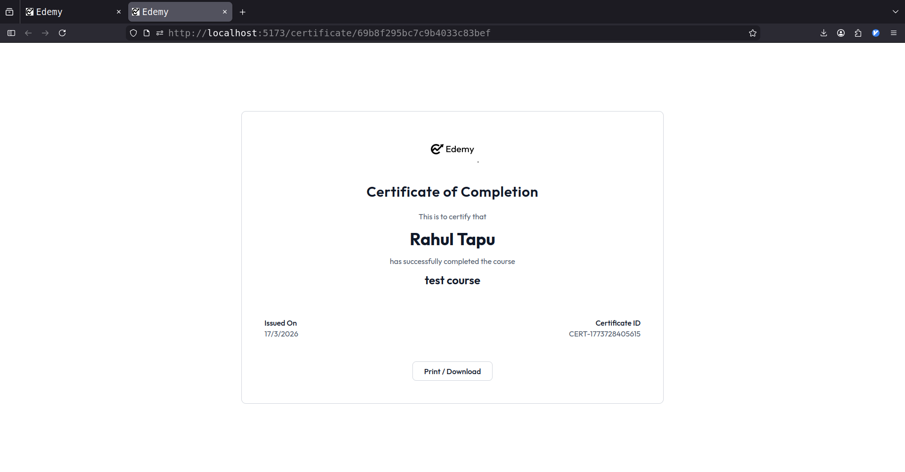

Slide 52
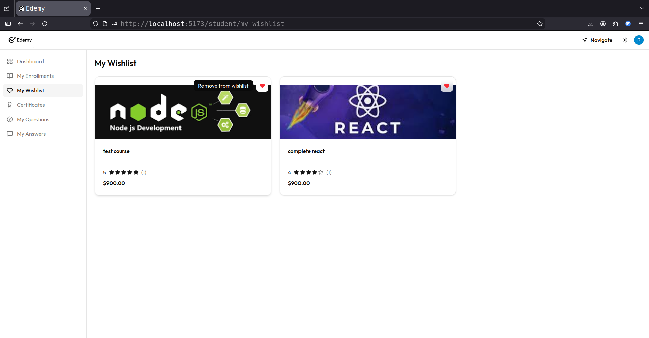

Slide 53
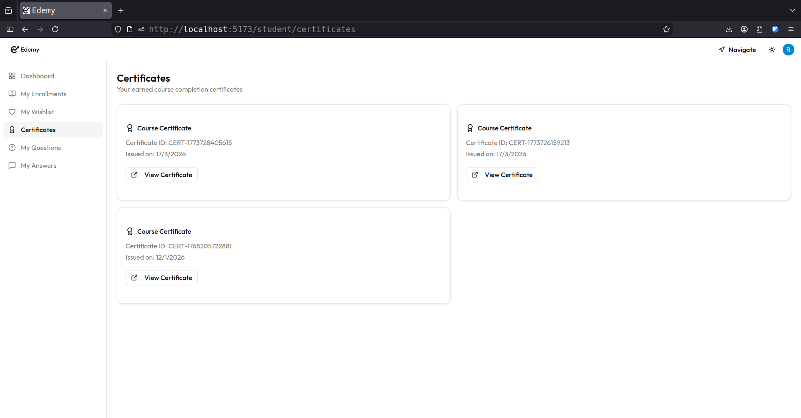

Slide 54


Slide 55


Slide 56


Slide 57


Slide 58


Slide 59
BIBLIOGRAPHY
Search Engine : Google
Online Resources:
  http://www.mongodb.com
  http://www.nodejs.org
  http://www.expressjs.com
  http://www.react.dev

